Slide 1
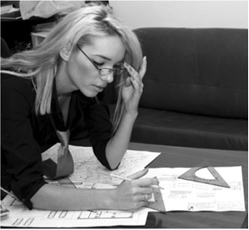
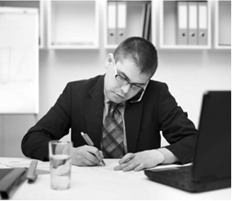
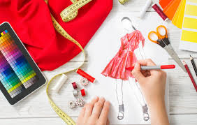

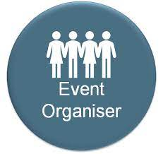
Which job do you think is more interesting? Why?

Slide 2

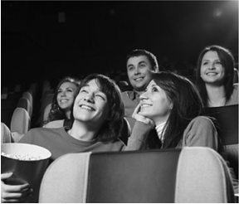

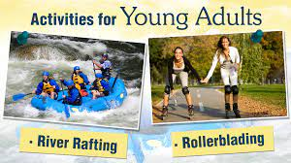
Which free-time activity do you think is more popular with young people? Why?

Slide 3
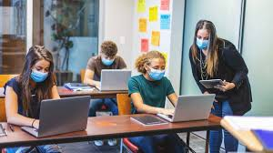
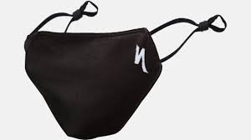
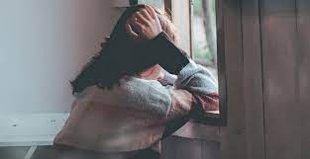
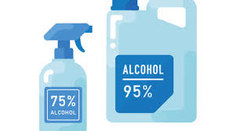
How did covid-19 affect you or people around you? Depression is an issue in today’s world, how can you fight it?

Slide 4
Use the following vocabulary:
Better salary, career prospects, promotion chances, foster your creativity, my soft skills/hard skills would adapt better
Social recognition, good working environment
Implies long working hours, teamwork,
Great fun, watch complete seasons, more comfy at home, , adrenaline boost, outdoor activity, meet people with the same interests,
Dangerous, contagious, irresponsible, keep a safe distance , wear a face mask, limit face-to-face contact, social distancing, disinfectant available everywhere, lockdown, vaccination, social isolation, premature death, economic recession
Feeling down, look for counselling, talk to your frinds and family, practice sport, find a target in life, socialize…

